Slide 1

OBSESSION AND ADDICTION
Short Awareness Video about Social Media
Adobe Video Production

Slide 2
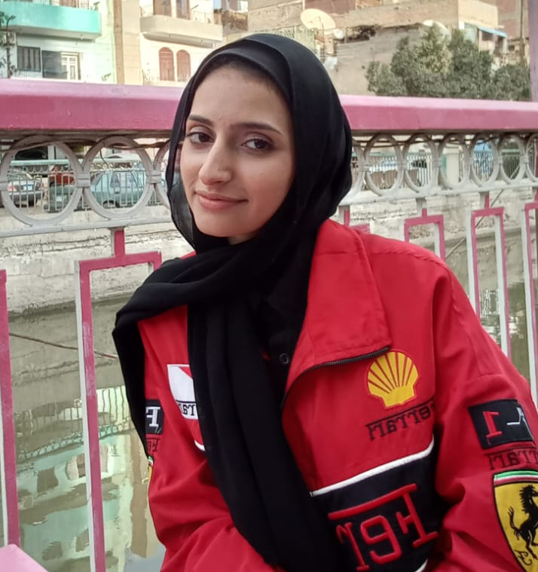


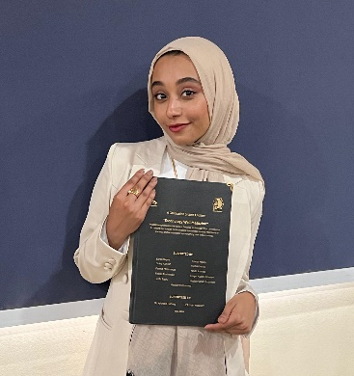
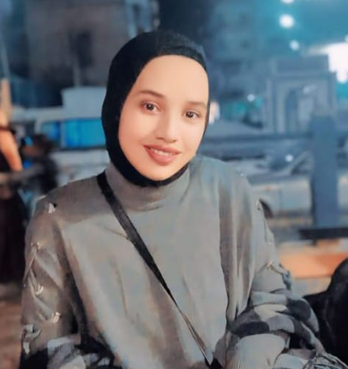
1
TEAM MEMBERS
Somaya Ramadan
Shaimaa
Ali
Nada
Ashraf
Fedaa Mahmoud
Yasmen
Ahmed
Adobe Video Production

Slide 3
2
AGENDA
Introduction
Sound and Music
Idea and Inspiration
Editing and Motion
Preparation
Production Timeline
Photography
Adobe Video Production

Slide 4

3
INTRODUCTION
An awareness video for social media users who are obsessed with staying away from their social life with family and friends, and negatively affecting them in the future, such as blackmailing most girls, which is widespread due to being attracted to deceptive appearances, with some advice for them and benefiting from using social media.
Adobe Video Production

Slide 5
4
IDEA AND INSPIRATION
When thinking a lot about the idea for our project, we saw the spread of electronic blackmail of girls more during this period Still, with the presence of parents and their containment of the boys and the competent authorities helping them, it had a great impact in helping them, but there is also a percentage of them who still fall into this trap.
Adobe Video Production

Slide 6
5
PREPARATION
1
Writing detailed scenes for filming, prioritizing each scene, timeline, and narrator's voice to clarify the meanings of the scenes.
Adobe Video Production
2
Choose the required filming locations to clarify their meaning, with the lighting and the equipped filming tools, and specify the required music, sound, and visual effects.

Slide 7
6
PHOTOGRAPHY
Photography Locations
Photography Tools
The difference in places over time indicates a waste of time browsing instead of looking at what is useful and the negative use of social media sites.
Standardized video size is available on phones, shooting with excellent phones for better quality, clear colors, and high resolution.
Adobe Video Production

Slide 8
7
SOUND AND MUSIC
Sound
Determine one tone of voice for a girl for the voiceover In the background, the scenes mimic, like the series " حكايات بنات ".
Music
Download background music for the video and the required effects such as tension, fear, anxiety and, a clock to set the scene audibly.
Adobe Video Production

Slide 9
8
EDITING AND MOTION
Editing
Integrating both animation and editing in Premiere & After Effects, and working with them together increased the accuracy and beauty of the scenes.
Scenes from the videos and cut locations have been carefully selected for each clip in keeping with voice over.
Adobe Video Production
Motion
Animate texts and graphics and add the necessary effects to clips.

Slide 10
9
PRODUCTION TIMELINE
Step 1
Step 3
The first period (5 days) is to choose the idea, modify the script, and determine the storyline to facilitate the work.
The third period (5 days) is to determine the graphics and sound effects and upload them. Re-shoot some clips, and edit the voice-over.
Adobe Video Production
Step 2
Step 4
The second period (3 days) is for filming clips, changing some situations, locations, lighting. And recording voice-over.
The last period (5 days) is for video editing, graphic animation, and video finalization with audio.

Slide 11
Adobe Video Production
THANK YOU

